Slide 1
Cloud Computing

Slide 2
What is Cloud Computing?
Cloud computing is a model for enabling convenient, on-demand network access to a shared pool of configurable computing resources (e.g., networks, servers, storage, applications, and services) [Mell_2009], [Berkely_2009].
It can be rapidly provisioned and released with minimal management effort.
It provides high level abstraction of computation and storage model.
It has some essential characteristics, service models, and deployment models.

Slide 3
Essential Characteristics
On-Demand Self Service:
A consumer can unilaterally provision computing capabilities, automatically without requiring human interaction with each service’s provider.
Heterogeneous Access:
Capabilities are available over the network and accessed through standard mechanisms that promote use by heterogeneous thin or thick client platforms.

Slide 4
Essential Characteristics (cont.)
Resource Pooling:
The provider’s computing resources are pooled to serve multiple consumers using a multi-tenant model.
Different physical and virtual resources dynamically assigned and reassigned according to consumer demand.
Measured Service:
Cloud systems automatically control and optimize resources used by leveraging a metering capability at some level of abstraction appropriate to the type of service.
It will provide analyzable and predictable computing platform.

Slide 5
Service Models
Cloud Software as a Service (SaaS):
The capability provided to the consumer is to use the provider’s applications running on a cloud infrastructure.
The applications are accessible from various client devices such as a web browser (e.g., web-based email).
The consumer does not manage or control the underlying cloud infrastructure including network, servers, operating systems, storage,…
Examples: Caspio, Google Apps, Salesforce, Nivio, Learn.com.

Slide 6
Service Models (cont.)
Cloud Platform as a Service (PaaS):
The capability provided to the consumer is to deploy onto the cloud infrastructure consumer-created or acquired applications created using programming languages and tools supported by the provider.
The consumer does not manage or control the underlying cloud infrastructure.
Consumer has control over the deployed applications and possibly application hosting environment configurations.
Examples: Windows Azure, Google App.

Slide 7
Service Models (cont.)
Cloud Infrastructure as a Service (IaaS):
The capability provided to the consumer is to provision processing, storage, networks, and other fundamental computing resources.
The consumer is able to deploy and run arbitrary software, which can include operating systems and applications.
The consumer does not manage or control the underlying cloud infrastructure but has control over operating systems, storage, deployed applications, and possibly limited control of select networking components (e.g., host firewalls).
Examples: Amazon EC2, GoGrid, iland, Rackspace Cloud Servers, ReliaCloud.

Slide 8
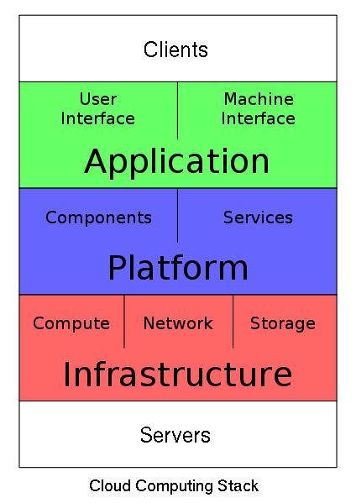
Service Models (cont.)
Service Model at a glance: Picture From http://en.wikipedia.org/wiki/File:Cloud_Computing_Stack.svg

Slide 9
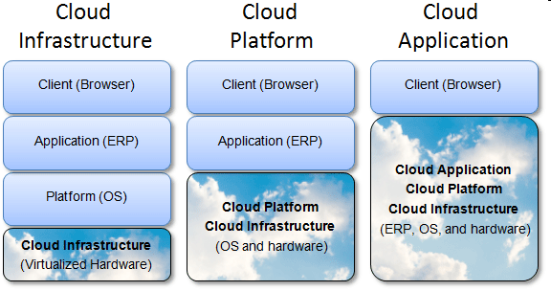
From another perspective

Slide 10
Deployment Models

Slide 11
Private Cloud:
The cloud is operated solely for an organization. It may be managed by the organization or a third party and may exist on premise or off premise.
Community Cloud:
The cloud infrastructure is shared by several organizations and supports a specific community that has shared concerns.
It may be managed by the organizations or a third party and may exist on premise or off premise

Slide 12
Public Cloud:
The cloud infrastructure is made available to the general public or a large industry group and it is owned by an organization selling cloud services.
Hybrid cloud:
The cloud infrastructure is a composition of two or more clouds (private, community, or public).

Slide 13
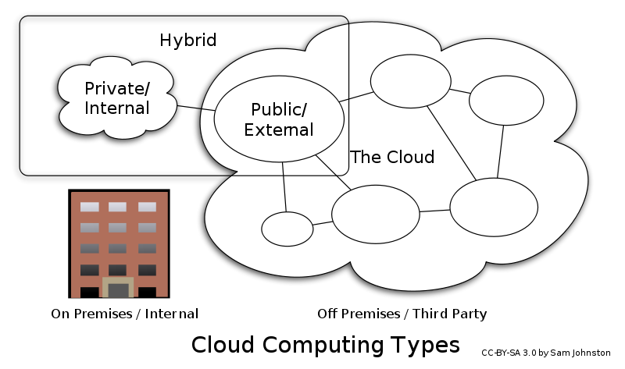

Slide 14
Advantages of Cloud Computing
Cloud computing do not need high quality equipment for user, and it is very easy to use.
Provides dependable and secure data storage center.
Reduce run time and response time.
Cloud is a large resource pool that you can buy on-demand service.
Scale of cloud can extend dynamically providing nearly infinite possibility for users to use internet.

Slide 15
General Security Advantages
Shifting public data to a external cloud reduces the exposure of the internal sensitive data
Cloud homogeneity makes security auditing/testing simpler
Clouds enable automated security management
Redundancy / Disaster Recovery

Slide 16
General Security Challenges
Trusting vendor’s security model
Customer inability to respond to audit findings
Obtaining support for investigations
Indirect administrator accountability
Proprietary implementations can’t be examined
Loss of physical control

Slide 17
Issues - Other
Privacy
Greater ease in which the companies hosting the cloud services control, and, thus, can monitor at will, lawfully or unlawfully, the communication and data stored between the user and the host company
Standards
Most cloud providers expose APIs that are typically well-documented but also unique to their implementation and thus not interoperable. Open Cloud Consortium is working this issue
Legal
E-Discovery
Search Warrants and Customer data
Cross-jurisdiction compliance
Patents

Slide 18
Issues for the Geospatial Community
Security, Privacy and Confidentiality
Safeguards needed to protect confidential information and services. Especially true for location content and applications
Performance
Existing geospatial applications may not be structured (architectured) correctly for the cloud
Revenue models
Much to be learned here
Data Usage
An individual's internet usage could soar as large files are sent via the internet between the user's computer and the data center

Slide 19
SOA (SERVICE ORIENTED ARCHITECTURE )
REFER TEXT BOOK

Slide 20
What is SOA?
SOA – Service Oriented Architecture
S – Service is basically an independent component that has a certain function. (e.g. Viewing online bank statement, filling out an app for an account). Emphasis on modularity and loose coupling (implementation hidden)‏
A – Architecture basically means this is not a technology but an approach to software design

Slide 21
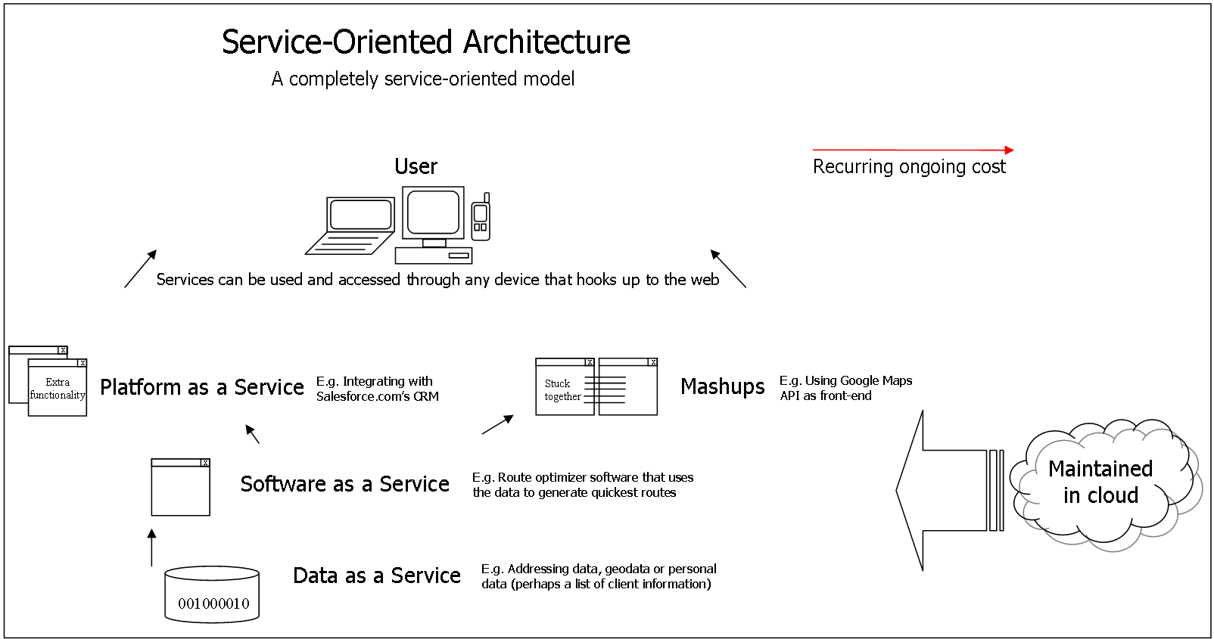

Slide 22
What is SOA?
How do services talk to eachother?
In the past through COMs or ORBs, but recent SOAs using Web Service (i.e. XML based messaging)‏
Adhoc philosophy
Platform, language, OS independent.
More recently, services are being offered for a price, like in the travel industry, financing, using off the shelf software services

